Slide 1
Budgeting and Savings Strategies (during Covid-19) Presentation to CUPFA Wednesday June 10, 2020, 19 – 20 h followed by Q&A
Presented by: Riccardo Romeo, CFA, CMT
Summus Investment Management Inc.
www.summusinvestment.com

Slide 2
Disclaimers
Opinions expressed in this presentation are my own, and do not necessarily reflect the opinions of Summus Investment Management Inc. These opinions are subject to change without notice.
All efforts have been made to assure the accuracy and integrity of the information presented in this presentation. Although all facts have been obtained from sources believed to be reliable, the information is not guaranteed, and neither is the presenter liable for any errors, omissions, or contradictions found in this text.
This presentation is for informational and educational purposes only and is not to be construed as solicitation, recommendation or offer to buy or sell any security, investment product, commodity, etc.. or use any strategy or system.
Any savings, health or financial decisions taken by you is done at your own risk and I, nor Summus Investment Management Inc., or our employees, assume any liability. Always consult a qualified insurance, health, investment expert that knows your personal financial situation which includes your health, risk tolerance, time horizon and investment objectives prior to making any health related, investment, or insurance decision in this presentation.
Worksheet was taken from Money Sense https://www.moneysense.ca Financial plan kit and MS-Excel spreadsheet was taken from https://www.vertex42.com/ but were modified to fit the income and expense categories described in this presentation. Inaccuracies in categories or calculation methodologies may exist and are to be used at your own risk.
All information provided from external sources have been cited or used with permission. This presentation has been prepared for and is the property of CUPFA under agreement with Summus Investment Management Inc. where the latter retains the right to use this presentation and any concepts or material for future purposes.

Slide 3
Summary
About me
Goals of this presentation
Financial Goals
How to create a Budget step by step
Use paper worksheet or MS-Excel spreadsheet provided
Net Income and revenue maximization tips
Spending and expense reduction tips
Questions

Slide 4
About me
Portfolio Manager Associate at Summus Investment Management Inc. (a private client investment firm), > 20 years industry experience
BCom Finance McGill University, Chartered Financial Analyst (CFA) and Chartered Market Technician (CMT) designations
Worked as Compliance Supervisor, Investment Advisor/Associate/Assistant, Analyst, and Branch Manager at Laurentian Bank Securities, IG Wealth Management, National Bank Financial (Private Banking 1859), CIBC (Wood Gundy) and TD
Supervised and advised > 300 Investment Advisors & Portfolio Managers
Reviewed thousands of client accounts and strategies
Part time Finance lecturer at Concordia University JMSB, Montreal CUPFA member
Interests in gardening, home renovations and travel
Passionate about investments, saving and making people money,
teaching, and coaching

Slide 5
Determining your financial goals
What are your financial goals? Most people do not have specific goals
Spend less, by how much?
Create an emergency fund?
Go on a dream vacation, buy a car, buy a house, retire well (where, how much money to have available)
Secret: Treat savings for your financial goals as an expense! Pay yourself first! Financial and savings goals must be specific.

Slide 6
Goals of this presentation
Help provide and empower you with :
Determining your financial goals
General money savings principles
Creating a budget step by step using specific tools
Net Income and revenue maximization tips
Spending and expense reduction tips
“Is this a moment of glass half empty or half full?”

Slide 7
General money savings principles
Think in terms of after tax dollars needed to pay or cost to buy something. Example: How much do you have to earn before tax to buy/or save $200? Depends on your income tax rate
It’s cheaper to hire out sometimes
Adopt a deferral mindset! Reducing spending and expenses pays yourself back but for something else better
Save money for a rainy day, it’s cool to be frugal
Explore lower cost alternatives. Takes time and planning It’s not necessary to always buy new, consider reusing, buying used or waiting for discount pricing or price matching
Always get 2 or more estimates, word of mouth referrals is best
Pay bills on time – avoid paying interest and protect credit score

Slide 8
How to create a Budget step by step
Step 1: Determine your financial goals and write it down
Step 2: Write down your current actual monthly and annual expenses
Use the tools provided; paper worksheet or MS-Excel spreadsheet (more detailed)
By doing so, you will see where you spend your money
Deficit or surplus? Spending more than you thought?
Step 3: Reduce expenses, start with easy ones. Can some fixed and unnecessary discretionary variable expenses be reduced?
Some will be easy, but some will require hard choices to be made
Remember, reducing your expenses is to pay yourself back but for something else
Enter these amounts in monthly new column on worksheet or in the next months on spreadsheet
Step 4: Track your revised expenses, is your monthly budget and financial goals on track? Were reductions realistic?
Step 5: Tweak expense amounts, find sources of additional revenue. Review Steps 4 & 5. This will be your “Monthly target”

Slide 9
Income and Revenue augmentation tips
Net Income from employment
Minimize unnecessary deductions if you can’t afford it; retirement savings plan contributions, reduce income tax deducted at source (Canadians can qualify to do this) as per Covid-19 benefits. Reinstate when times get getter
Other Income (e.g. rental income, government benefits)
Can you rent an unused part of your house (basement, storage, etc.)?
See your government’s COVID19 incentives. Canadian Covid19 tax incentives are ever changing: https://www.canada.ca/en/revenue-agency/campaigns/covid-19-update.html
Investment income
Make sure all your money earns acceptable interest, dividends and capital gains
Avoid panic selling, making emotional mistakes – the market always come back in the long term
Reduce investment management fees – more on that later

Slide 10
Income and Revenue augmentation tips
Income from your hobby
Do you have a hobby that does not interfere or compete with your day job that you can earn income from?
Examples: Arts and crafts, jewelry making, painting, specialized services
Can this be converted into a revenue generating part time source of income?
Refunds/Reimbursements/Gifts Received
Have you collected on all monies and reimbursements owed to you?
Someone promised you an incentive never received? Now’s the time to follow up!
Unused gift cards that you forgot you had?
Did you apply for all Covid-19 supplements offered by Quebec and Canada?
Some governments have a registry for assets forgotten and held on behalf of the individual. Quebec example: https://www.curateur.gouv.qc.ca/registres/en/criteres.jsp

Slide 11
Income and Revenue augmentation tips
CUPFA Reimbursement for Small Claims
For professional development expenses and professional fees incurred from May 1, 2020 – April 30, 2021 budget year
2020 deadline was March 30, 2020
Items you may be allowed to claim; Internet, books, software, association memberships, periodical subscriptions, etc. For more information see:
https://cupfa.org/wp-content/uploads/2019/09/SmallClaimsProfFeesInfo-Form2019.pdf
https://cupfa.org/professional-development/small-claims/

Slide 12
Income and Revenue augmentation tips
Selling unused and unneeded items
We all have stuff that we haven’t used that may be in a decent condition and still has value, especially to others
Rule of Thumb: You didn’t use it in the last 2 years, consider getting rid of it! This could be another revenue or cash flow source
Examples: Items in storage, furniture, household items, etc.
Be careful not to sell items of value, heirlooms that will appreciate in value or that you will regret you sold
Sites to consider: Facebook Marketplace, Kijiji, Varage, etc

Slide 13
Spending and expense reduction tips on important expense items
Item and slide# | Item and slide# | Item and slide# | Item and slide#
Mortgage / Rent, condo fees 14 | Health Care Insurance Premiums, Medicine, Drugs, Professionals 18 | Loans, personal loans /lines of credit, student loans 24 | Clubs / Dues / Professional Memberships 30
Insurance analysis, general comments 15 | Transportation, parking, gas, car payment and insurance 19 | Savings 25 | Gifts - Birthdays, Christmas, other 31
Property tax / insurance 13 | Transportation, Uber / Taxis / Bus 20 | Groceries, personal supplies and care 26 | Charitable Donations (if paid annually) 31
Heat / gas / electricity 16 | Water/Sewer/Trash 21 | Lunches at work, Coffees, and snacks 27 | Children’s Activities and/or Hobbies 32
Netflix, Cable/Satellite, Internet 16 | Investment Management Fees 21 Bank Account Fees / interest 22 | Entertainment (Dining out, movies, etc.) 28 | Buying new versus Used: Big ticket item and durable goods purchases 31
Phone, Cell Phone(s) 17 | Credit cards / debit cards 23 | Home Repairs, Renovations and Maintenance 29 | Professional / Accounting Fees Travel & Vacations 39-40

Slide 14
Spending and expense reduction tips on important expense items
Mortgage / Rent, condo fees
Can mortgage be renegotiated with a lower rate? Fixed or variable rate?
Always check a minimum of 2 providers for any estimate or renewal. Calculate penalty, must be worth it. Negotiate hard
Cheaper to rent than to own, or own versus rent? Carefully consider condo fees, moving, property tax, and maintenance upkeep costs before any major move
Is rent too high? Move to another location for lower rent that will also save on transport costs?
Property tax / insurance
Too much house for your needs? Downsize?
Pay bills on time, or else they will charge you interest
Ensure you are qualifying for all property insurance discounts (Example: fire hydrant, hot water tank replacement)
Contest your property market value with the municipality? Some allow you to do so

Slide 15
Spending and expense reduction tips on important expense items
Insurance analysis, general comments*
Consider combining auto, home and other insurance to one provider to maximize annual discounts
Many companies boast several hundred dollars in annual savings for multiple insurance policies
Be careful for multiple year contracts and contract break fees
Prepare yourself to get another insurance quote every year in order to keep your provider “honest.” Start this process 2 months before your contract expires. Take detailed notes. Make sure that you are getting a lower price for equal or greater coverage. Use a licensed agent
*Consider consulting an insurance agent or expert for advice specific to your situation

Slide 16
Spending and expense reduction tips on important expense items
Heat / gas / electricity
Be efficient with consumption
Use LED and energy efficient lighting
Air sealing provides biggest bang for your dollar (outlet insulation, caulking, gap and window sealing)
Netflix, Cable/Satellite, Internet
Is cable subscription necessary when you have Netflix?
Change internet provider for a similar service at a lower cost?
Amazon Firestick or other channel device cheaper?

Slide 17
Spending and expense reduction tips on important expense items
Phone, Cell Phone(s)
Time to cut the residential cord?
Cell phone plan/contract too expensive – Canadians overpay!
Change cell phone provider?
Do you need all that data?
Do you really need that new Apple iPhone upgrade? Change plans with existing phone

Slide 18
Spending and expense reduction tips on important expense items
Health Care Insurance Premiums, Medicine, Drugs, Professionals
Have you shopped around?
Cheaper and more coverage on your spouses’ private plan than yours? – Look into it
Are you taking prescription drugs? Consider switching to generics versus brand name?*
Always verify if expensive medical procedures will be covered by your insurance provider first. Go for a second professional opinion to compare
Treat your health as a priority – stay healthy it also saves money
Be careful not to go over maximum allowable amounts per health care practitioner covered by your insurance coverage
Submit insurance claims Rapido-presto, set up auto transfer funds to your bank account
*Ask your Doctor and/or pharmacist

Slide 19
Spending and expense reduction tips on important expense items
Transportation, parking, gas, car payment and insurance
How costly is your methods of transportation?
Consider public transportation cost and time efficiency
Car ownership is expensive, is 1 or 2 cars essential? Look at kilometre/mile usage per day, per year and use purpose
Is it worth it to drive to work with gas, parking, ticket expenses and use of your time?
Do you need a Ferrari to go to work in? Should you downsize your vehicle, payment and thus insurance cost? Ask for insurance quote before you settle on another car
Do you really need to buy new? Consider lease transfer www.leasebusters.com, or buying from a certified used dealer with valid warranty, low monthly lease payments with $0 interest. More on buying new later

Slide 20
Spending and expense reduction tips on important expense items
Transportation, Uber / Taxis / Bus
Consider buying a bicycle with a helmet for short distance commuting
Put a basket / wheel rack on it for more versatility

Slide 21
Spending and expense reduction tips on important expense items
Water/Sewer/Trash
Make sure you have no water leaks (toilets, faucets)
Reduce trash if you pay by kilo/pound – by reusing, recycling and composting
Investment Management & Fees (This is my specialty)
Canadians overpay for hidden management fees in their Mutual Funds
Average Management Expense Ratios (MERs) for mutual funds = 2.00 - 2.50% deducted from your returns
Evaluate your advisor’s service and investment performance annually
For > $150,000 in investible assets, mutual funds ARE NOT the most efficient investment vehicle registered and especially nonregistered investment accounts. Save about $1500/year in fees with a portfolio manager and managed fee account / Exchange Traded Fund (ETF) strategy*
*Amounts will vary. Ask an investment professional for a second opinion

Slide 22
Spending and expense reduction tips on important expense items
Bank Account Fees / interest
Analyze how many transactions, cheques, payments you make per month
Choose an account for you with little or no monthly fees, may need to maintain a minimum monthly balance thus weigh the opportunity cost of this. You may need to shop around
Americans have better choice, Canadians deal with an oligopolistic banking industry. Look at credit unions or new entrants
https://www.canada.ca/en/financial-consumer-agency/services/banking/bank-accounts/low-cost-no-cost.html
https://www.tangerine.ca/en/products/spending/chequing-account/?ds_rl=1006592&gclid=EAIaIQobChMIq5aY1YCi6QIVDJSzCh3yIA5cEAAYASADEgJ9zvD_BwE&gclsrc=aw.ds
If monthly fees are unavoidable, opt for lowest monthly fee with enough transactions
Difficult to find an institution that pays decent interest on credit balances

Slide 23
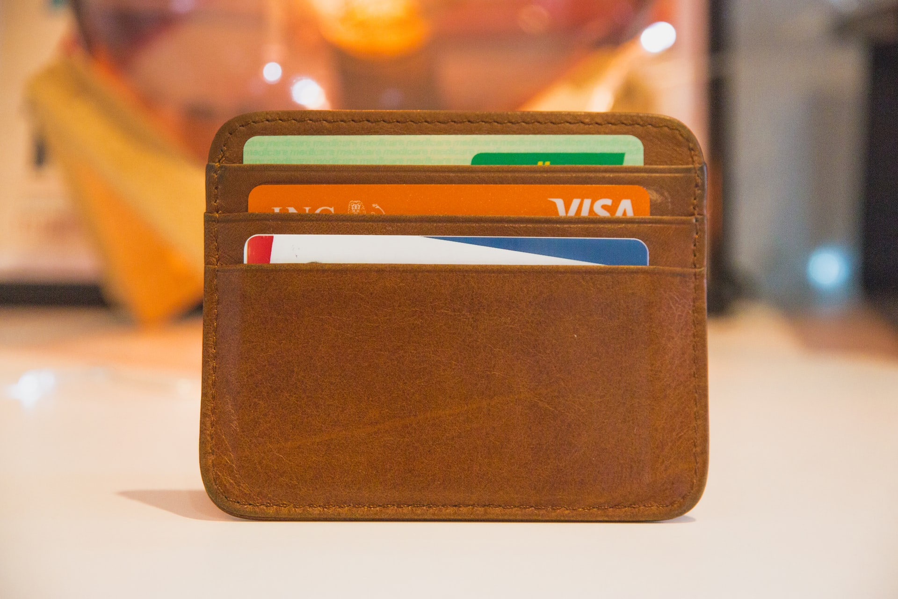
Spending and expense reduction tips on important expense items
Credit cards / debit cards
Convenient but dangerous to loose track of spending. Use debit cards sparingly
Have a maximum 2 credit cards!
Choose a credit card preferably with: no annual fee, cash back or some reward, average interest charge, annual summary of expenses by category, and widely accepted. Independent survey of best credit cards:
Canadians → https://www.moneysense.ca/spend/credit-cards/best-credit-cards-in-canada/
Americans → https://www.cnbc.com/select/best-credit-cards/
Only buy what you can pay for, never carry a balance
Have a main card to keep tab of your expenses, pay most of your expenses with one card
Pay bills on time and avoid interest charges. Secret: Set up auto payment of minimum or full monthly balance from your bank account!
Review statements monthly to ensure accuracy, recurring or unauthorized transactions. Call merchants to cancel and reimburse for any recurring expenses that you did not know of

Slide 24
Spending and expense reduction tips on important expense items
Loans, personal loans /lines of credit, student loans
Given low interest rates now, consider consolidating debt especially credit card debt with one low interest loan
Consider a line of credit – only for emergency or to backstop chequing account from going overdrawn purposes only(negative balance)
Choose same financial institution as bank/chequing account
Understand payment rules: interest only, interest + principal, minimum payment, etc.

Slide 25
Spending and expense reduction tips on important expense items
Savings
Treat savings as a fixed cost and amount per month
Establish multiple savings goals:
Emergency fund
Vacation
New home
Retirement
Create auto contribution plans going into different accounts for each goal
You will have to defer immediate gratification for some intermediate or long term goals

Slide 26
Spending and expense reduction tips on important expense items – variable
Groceries, personal supplies and care
Determine at which store(s) you get the most for your money
Price matching, couponing takes time but can be worth it
Know which stores to go to for what product, reduce sorties
Consider diet changes, whole food plant-based meals are less expensive
Grow a garden, start small. Growing tomatoes, kale, lettuce, swiss chard is easy and can be done from anywhere
Consider reducing your soap and cleaning product purchases by doing it yourself (DIY) which is environmentally and wallet friendly. Some are Zero waste. These links are from a friend of mine:
https://www.youtube.com/watch?v=qMhSORxzrdA&authuser=0
Use rags instead of paper towels
Zero Waste Deodorant https://youtu.be/42Htnp8P9Eg
Zero Waste Bathroom Essentials / Toiletries https://youtu.be/QMAo9O40zp0
Make Your Own Hand Soap https://youtu.be/Es6LbaY3RfU

Slide 27
Spending and expense reduction tips on important expense items - variable
Lunches at work, coffees, and snacks
You can save a lot of money in this category by considering alternatives. It takes time and planning. Look at the difference the last month has made at home!
Lunch: Find out your frequency of eating out and reduce it by preparing your own lunch for a fraction of the cost. Example: 3 X per week @ $20 = $60 per week, $260/month, $3120 per year!!
Coffee: What is your Tim Horton’s / Starbucks or coffee purchase frequency? Example: 1 Starbucks gourmet coffee per day = $5.75 X 21 days per month = $126.50 per month!! Or $1518 per year!! This is one person’s vacation! Investigate alternatives: buying your favourite brew, a resilient coffee mug, and a coffee machine for a fraction of the cost
Snacks: Cut out snack purchases at convenience stores, coffee shops and restaurants. Buy healthy or other snacks in bulk at Costco, prepare in advance
Secret: Make eating out a special occasion not the norm, buy good storage containers, plan in advance

Slide 28
Spending and expense reduction tips on important expense items - variable
Entertainment (Dining out, movies, etc.)
Another big discretionary spending category worthy of analysis
What is your eating out frequency per week, month? It likely can be cut
Example $200 / month to eat out with family twice a month = $4800/yr!
Reduce frequency, change to lower cost venues that you like
Research lower cost dating and entertainment cost alternatives. There is always something to do in town that is free or of minimal cost. Consult your favorite activities websites. It takes creativity and time!
https://www.timeout.com/montreal/things-to-do/free-things-to-do-in-montreal
Go for a romantic picnic

Slide 29
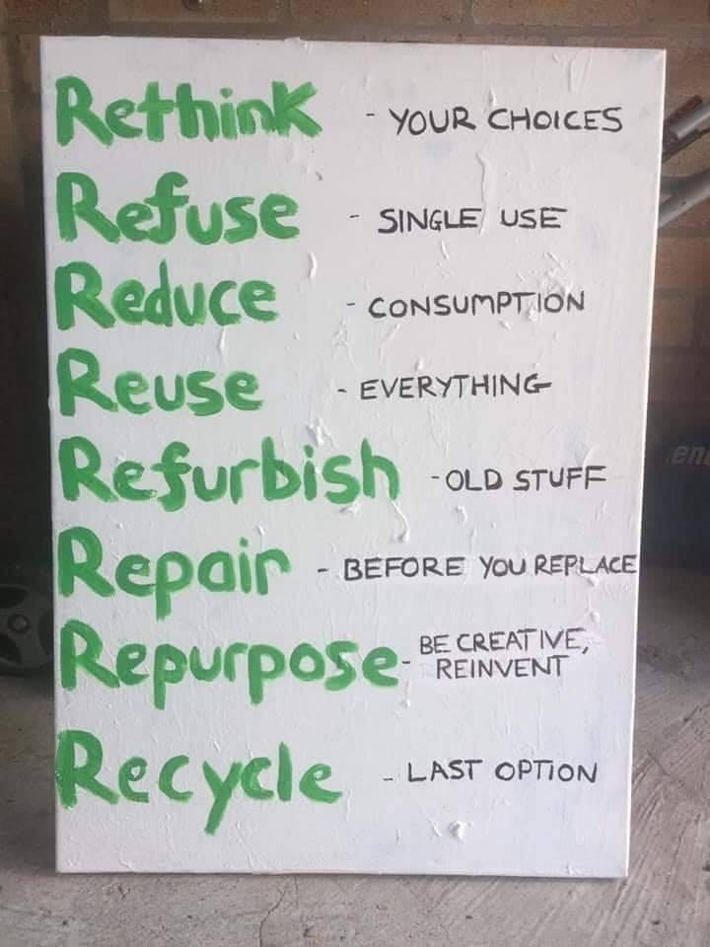
Spending and expense reduction tips on important expense items - variable
Home Repairs, Renovations and Maintenance
Consider postponing or finding lower cost alternatives to home renos
Painting your house can do wonders. Consider doing it yourself. Major brands have low end product lines that are great. Recycled paint becoming more popular at 30% the price
If renos are a must always get a word of mouth referral and get a minimum of 2 estimates if not more for major work. You will be surprised of how much you can save and differences in opinion. You will learn from each estimate. Consider doing part of the required work to reduce costs
Consider doing like renos with a neighbor for savings discounts
Consider the RRRRRRRRs
Repair broken items, check YouTube videos for “how to..”
Refurbish old stuff, YouTube hack videos
Repurpose stuff without apparent use

Slide 30
Spending and expense reduction tips on important expense items - variable
Clubs / Dues / Professional Memberships
Analyze cost, usage and if it is still worthwhile to maintain
Are you using the gym membership or is it more convenient to have a home gym?
Other membership dues? Are you getting you money’s worth?
Professional dues, are they being tax deducted? More about taxes later

Slide 31
Spending and expense reduction tips on important expense items - variable
Gifts - Birthdays, Christmas, other
Reduce the amount you spend by buying more thoughtful gifts and not buying something for someone for the sake of buying because you “have to.” (We may tend to compensate by buying a pricey gift because we waited for the last minute and don’t know what the person really wants)
Spend more time and plan to get that something special
Consider buying items that are difficult to value, or newer stuff from used markets
Charitable Donations (if paid annually)
Charity begins at home. Evaluate whether you can afford donations, and if so, do it annually instead of monthly if possible

Slide 32
Spending and expense reduction tips on important expense items
Children’s Activities and/or Hobbies
We tend to overdo activities. Ask children which they prefer and consider continuing with these only
Consider self teaching, apps and you tube videos for hobbies and free courses (Ex: Music)
Consider valued purchases for arts and crafts purchases

Slide 33
Spending and expense reduction tips on important expense items
Buying new versus used: purchases of computer/electronics supplies, equipment, furniture / appliances / durable goods
Always evaluate if you need to really buy it new, and the discount if you buy it used
Usually can save at least 30 – 50% by buying items used, but evaluate risk vs. benefit. Some items (i.e. electronics without warranty) may not be worth the risk to buy used
If you must buy new, comparison shop and price match even for big ticket items and delay purchase until on special. Example: Home Depot price match for appliances
Check out used discounts on Facebook Marketplace, Kijiji, flea markets, local thrift shops etc. Hard to tell if you bought used!

Slide 34
Spending and expense reduction tips on important expense items
Professional / Accounting Fees
It usually pays to hire for professional advisory services especially for an accountant to do your tax filing instead of doing it yourself
Discuss your situation openly
Ensure that you are maximizing all tax deductions, home office?
Put your papers of expenses and questions in order before consultation
Consult Covid-19 benefits available to you from your country, at a federal, state(province) and city level. Ensure if you qualify, that you will apply for the benefit
File income taxes early before deadlines! Create auto transfer of funds if you are owed a refund, know deadline extensions for payments

Slide 35
Spending and expense reduction tips on important expense items
Travel & Vacations
Consider postponing major vacations or unnecessary travel especially in areas hardest hit by Covid-19
Road trips can be fun, consider staying local

Slide 36
Conclusion
Determine your financial goals
Budgeting and reducing expenses is easy with a step by step plan
Use savings principles
Reducing your spending and expenses is to pay yourself back, but for something else better later
Consider using income enhancing and spending and expense reduction tips
“ A penny saved is a penny earned”

Slide 37
Questions?
Follow me at: linkedin.com/in/riccardoromeo
Contact me for any questions at:
Riccardo Romeo, CFA, CMT
Gestionnaire de portefeuille associé | Associate Portfolio Manager
V.P. Directeur général | V.P. Managing Director
romeo@summusinvestment.com
Gestion de placements Summus Inc. | Summus Investment Management Inc.
1250, boul. René-Lévesque Ouest, Bureau 2200
Montréal (Québec), Canada H3B 4W8
Tél: (514) 989-2463 www.summusinvestment.com

