Slide 1
SLEEP SOLUTIONS FOR FAMILIES JUNE 3, 2020
Jamie Cassoff, PhD Certified Pediatric Sleep Consultant, The Kids' Sleep Clinic Psychology Professor, Concordia University

Slide 2
Overview
What is sleep?
Why do children need sleep?
Healthy Sleep Habits
When things go wrong
Questions & Answers

Slide 3
What is sleep?

Slide 4
What is sleep?
Circadian Process (When?)
Homeostatic Process (How Much?)

Slide 5
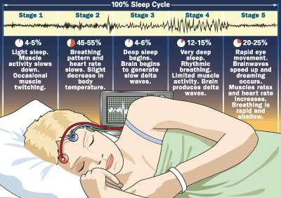
Stages of sleep
Rapid Eye Movements (REM): Associated with dreaming
Body is very still during REM sleep.
Non-REM (NREM) Sleep: Occurs during stages 1, 2, 3, and 4; no rapid eye movement occurs.
Seems to help us recover from daily fatigue.

Slide 6
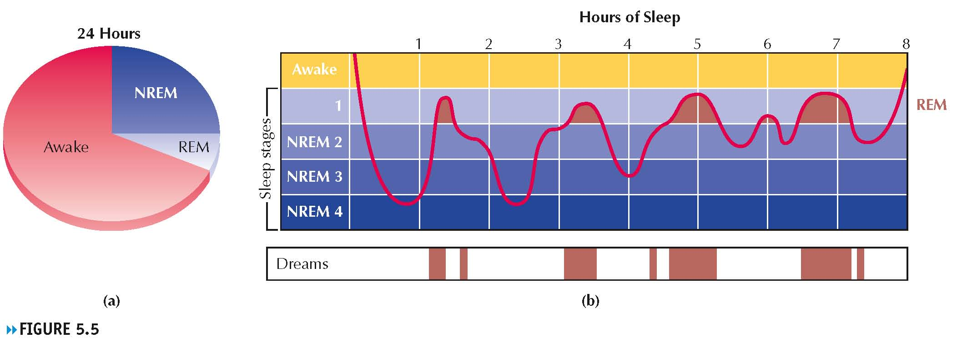
(a) Average proportion of time adults spend daily in REM sleep and NREM sleep. REM periods add up to about 20 percent of total sleep time. (b) Typical changes in stages of sleep during the night. Notice that dreams mostly coincide with REM periods.

Slide 7
Why do children need sleep?

Slide 8
How does sleep affect your child?
Nature Neuroscience, 2000
“Early brain development, learning, and memory are all supported by healthy sleep.”

Slide 9
Sleep and Academic Performance
Sleep Deprivation
Reduced Attention Span
Impaired Memory
Poor Organizational Skills
Frustrated
Distracted
Poor Motivation

Slide 10
Sleep and Social/Emotional Health
Sleep Deprivation
Irritability
Anxiety
Defiance
Poor Emotional Regulation
Temper Tantrums
Problems with Friends

Slide 11
Sleep and Chronic Disease
Short sleep duration results in metabolic changes that may be linked to obesity
This association has been reported in all age groups—but has been particularly pronounced in children.
Insufficient sleep in youngsters may adversely affect the function of a region of the brain known as the hypothalamus, which regulates appetite and the expenditure of energy:
Lower leptin level (Less Full)
Elevated ghrelin (More Hungry)
Enhanced appetite (More FOOD)

Slide 12
Sleep and Chronic Disease
Diabetes
Insufficient sleep is linked to an increased risk for the development of Type 2 diabetes.
Optimizing sleep duration and quality may be important means of improving blood sugar control in persons with Type 2 diabetes.

Slide 13
Sleep and Safety
Car accidents is leading cause of death in adolescents
Sleepiness = a leading cause of car accidents in adolescents and young adults
Compared with sleeping >8 hours each night
Sleeping 6-7 hours is associated with a 1.8 times higher risk for a sleep-related crash
Sleeping fewer than 5 hours per night results in a 4.5 times higher risk

Slide 14
Sleep and ADHD
In attention deficit hyperactivity disorder (ADHD) improvements in sleep lead to better behavior.

Slide 15
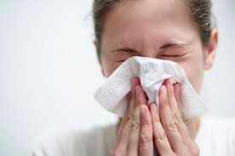
Sleep and the Immune System
Sleep deprivation negatively affects the immune system
Severe sleep loss jolts the immune system into action, which is the same response as exposure to stress

Slide 16
What are the consequences of sleep deprivation?
Sleep deprived adolescents report the following symptoms:
Feeling drowsy
Feeling tired
Feeling anxious
Having difficulty paying attention
Feeling stressed out
Having difficulty getting along with friends, family and other people
Experiencing mood swings
Showing lower performance in school
Lack of awareness

Slide 17
Healthy Sleep Habits

Slide 18
Recommended sleep by age source: modified from the sleepeasy solution, 2007
Age | Night | Day | Total
0-3 months | unpredictable, varies widely
3-12 months | 11-12 hrs | 2-4 hrs | 13-16 hrs
1-3 years | 11-12 hrs | 1½-3 hrs | 12½-15 hrs
3-6 years | 11-12 hrs | 0-2 hrs | 11-13 hrs

Slide 19
Bedtime Calculator
Sleepfoundation.org/bedtimecalculator

Slide 20
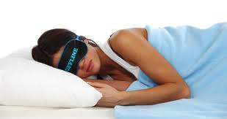
Sleep Hygiene
Sleep hygiene is a variety of different practices and habits that are necessary to have good nighttime sleep quality and full daytime alertness

Slide 21
Sleep Environment
Dark (nightlight acceptable)
Quiet
Same bed every night
Cool side of comfortable
No electronics in the room

Slide 22
Bedtime Routine
Physical activity
Bath or shower
Time in their sleep environment
Adjust to low level lighting
Book or quiet play with parent present
Cuddles, songs, or brief talk about the day
Lights out

Slide 23
Negative Sleep Hygiene Behaviours

Slide 24
Other Sleep Hygiene Recommendations
Go to bed at the same time each night and rise at the same time each morning
Expose yourself to bright lights in the morning

Slide 25
When things go wrong

Slide 26
Top reasons babies wake in the night
Sleep schedule not developmentally appropriate
Cannot fall asleep independently i.e. dependent on:
parental presence
rocking
nursing/bottle
pacifier etc.
Poor sleep environment
Poor bedtime routine

Slide 27
The 7 C’s for toddlers and school-aged children
Calm
Be Calm
Comsistent
Be Consistent
Caring
Be firm and Caring
Cuddle
Allow for Cuddle time
Confidence
Put to bed with Confidence
Conversation
Limit Conversation when it is time for bed
Congratulate
Congratulate yourself on a successful job

Slide 28
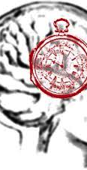
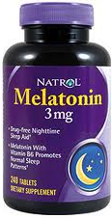
Teen Sleep
Teens’ biology makes them go to bed later
Delay in melatonin release
Individual lifestyles also play a part

Slide 29
Factors contributing to sleep in teenagers
Social pressures
Delayed sleep phase
School start times
Sleep Time
Genetic predisposition
Caffeine Misuse
Hormonal influence, obesity
Substance abuse

Slide 30
How common are irregular sleep patterns in teenagers?
90% of teenagers go to bed later and wake up later on weekends
If bedtime changes more than 2 hours between the week and weekend, it increases the chances of getting less than 8 hours of sleep on school nights

Slide 31
How are irregular sleep /wake hours treated?
Try to get teens to go to bed earlier
Go to bed 30 minutes earlier and wake up 30 minutes earlier
Bright Light Therapy
If symptoms are more severe, may be a sign of Delayed Sleep Phase Syndrome

Slide 32
When to Consult a Physician
1. Loud snoring
2. Breathing pauses or stops breathing while sleeping
3. Difficulty breathing while sleeping
4. Noisy breathing while sleeping/mouth breathing
5. Choking or gasping for air while sleeping
6. Complaining of leg pain or discomfort in legs while trying to fall asleep or during the night
7. Restless legs or frequent moving of legs while trying to fall asleep or during the night
8. Kicking legs in a rhythmic motion while sleeping.
Occasionally, sleep problems can be related to medical problems that can result in disturbed sleep. If you have answered “yes” to any of the questions above, take the time to mention this information to your child’s physician. Some of these symptoms, particularly when several are present, may indicate an underlying medical problem.

Slide 33
Resources
Waldburger J, Spivak J. The sleepeasy solution: The exhausted parent’s guide to getting your child to sleep – from birth to age 5. Deerfield Beach: Health Communications, Inc., 2007.
Mindell JA. Sleeping through the night: how infants, toddlers, and their parents can get a good night's sleep. Revised ed. New York: HarperCollins, 2005.
Canadian Paediatric Society – www.cps.ca, www.caringforkids.cps.ca
American Academy of Pediatrics – www.aap.org, www.healthychildren.org
National Sleep Foundation - www.sleepfoundation.org
Pediatric Sleep Council – www.babysleep.com
www.kidssleepclinic.com

Slide 34
Questions & Answers

